Slide 1
Grange PRIMARY SCHOOL YEAR 3/4 ENGLISH WORKSHOP
Monday 3rd October 2022

Slide 2
Workshop aims
• To explore the English curriculum in Years 3 & 4.
• To provide explanations and examples of key grammatical aspects of the Years 3 and 4 curriculum.
• To share websites for further information and support.

Slide 3
What is spag?
SPaG is made up of three elements:
• Spelling
•Punctuation
•Grammar

Slide 4
What are fronted adverbials?
Fronted adverbials are adverbs (words that describe a verb) that are moved to the front of the sentence. Adverbs are used to describe verbs (action words e.g. jump, laughed, sat, ate, etc.). Fronted adverbials described verbs but are placed at the beginning of a sentence. Here are some examples of sentences with a fronted adverbial: Quietly, Michael tiptoed into the room. As quick as a flash, mum tidied the room. Gracefully, the dancers pranced around the room.
The underlined words/phrases are examples of fronted adverbials. Children are encouraged to use fronted adverbials to find different ways of beginning their sentences.

Slide 5
fronted adverbials
Here are some examples of questions to show you the level of understanding the children are required to have:

Slide 6
fronted adverbials
If you would like further information about fronted adverbials, here are some video links for support:
https://www.bbc.co.uk/bitesize/topics/zwwp8mn/articles/zp937p3#:~:text=A%20fronted%20adverbial%20is%20when,the%20sentence%2C%20before%20the%20verb

Slide 7
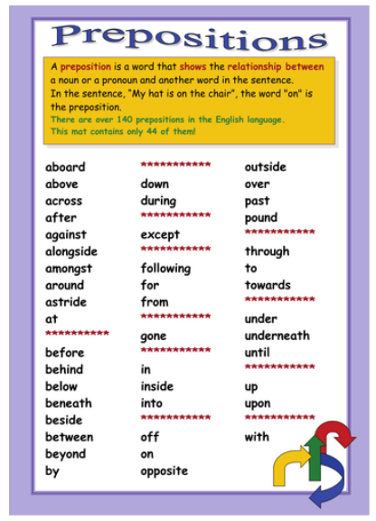
prepositions

Slide 8
prepositions
https://www.bbc.co.uk/bitesize/topics/zwwp8mn/articles/zw38srd

Slide 9
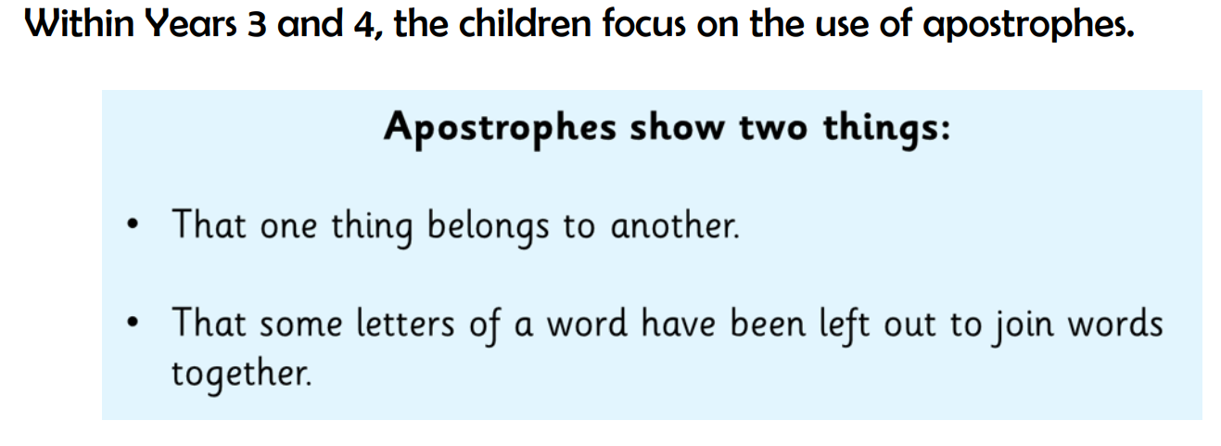
Apostrophes

Slide 10
Apostrophes
https://www.bbc.co.uk/bitesize/topics/zvwwxnb/articles/zx9ydxs

Slide 11
DIRECT SPEECH

Slide 12
spelling
https://spellingframe.co.uk/

Slide 13
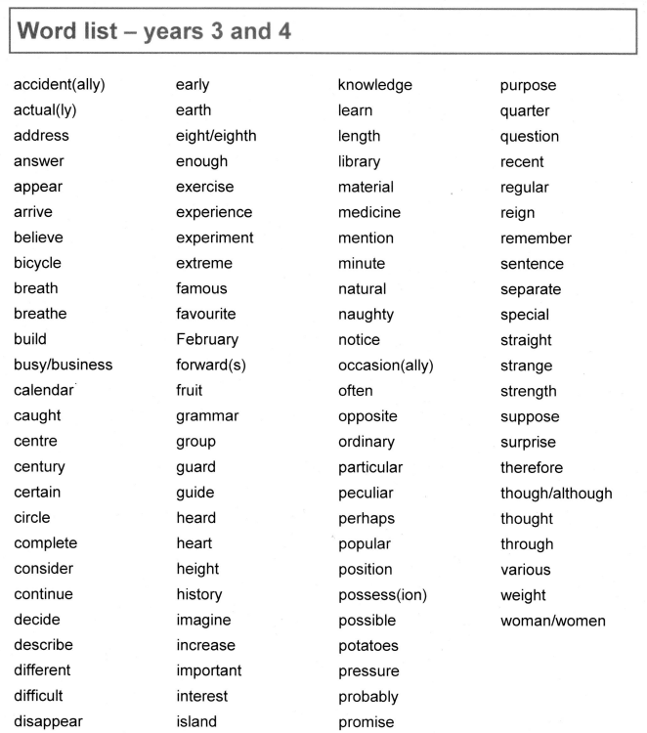
spelling

Slide 14
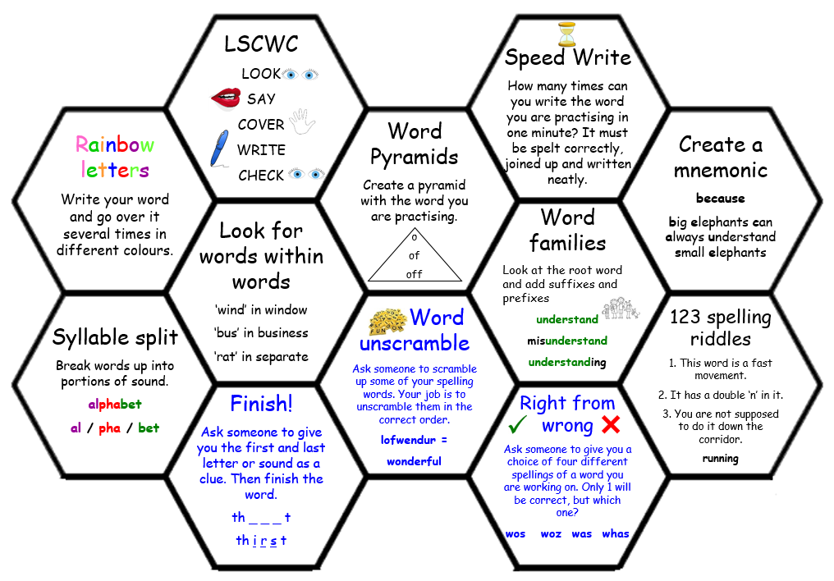
spelling

Slide 15
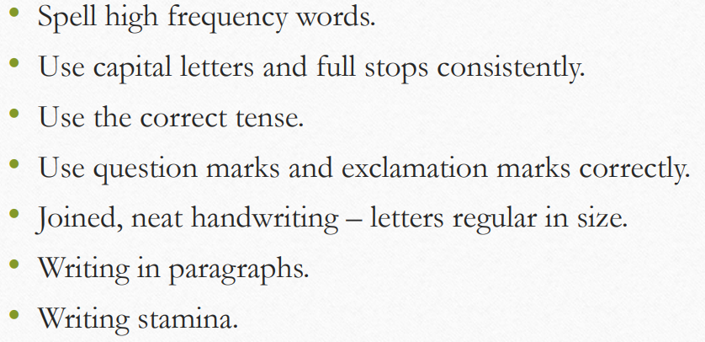
Basic skills

Slide 23
Question stems

Slide 24
Question stems

Slide 25
Question stems

Slide 26
Question stems

Slide 27
Question stems

Slide 28
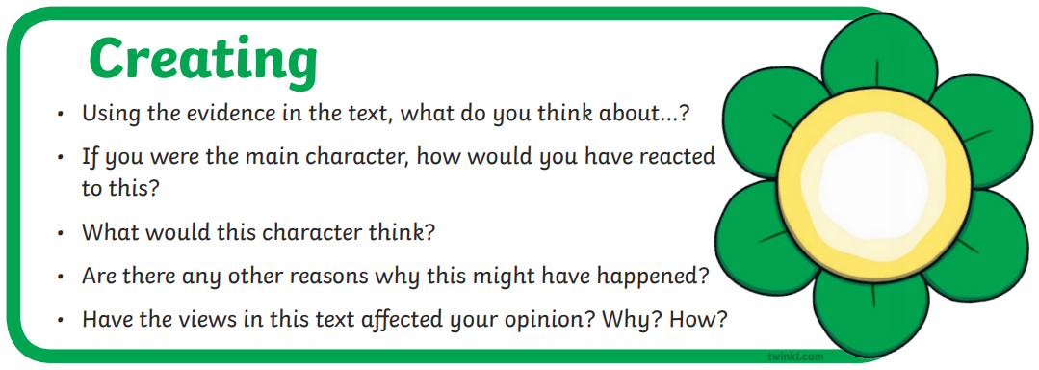
Question stems

Slide 29
USEFUL WEBSITES
https://www.spellingcity.com/
https://www.funenglishgames.com/grammargames.html
https://www.bbc.co.uk/bitesize/subjects/zv48q6f
http://www.primaryhomeworkhelp.co.uk/literacy/index.htm

